Slide 1
Software Testing Techniques

Slide 2
Contents
Black-Box test strategy
  Random testing
  Equivalence class partitioning
  Boundary value analysis
White-Box test strategy
  Path testing
  Control structure testing
    Control-Flow testing
    Data-Flow testing
    Loop testing
Software Testing - SE-UIT

Slide 3
Effective test case
A smart tester
  Maximize use of time and resources
  Develop effective test cases
A test case
  is a set of conditions or variables under which a tester will determine whether an application or software system is working correctly or not
Effective test case
  Has good possibility of revealing a defect
  Toward a higher-quality testing process
Software Testing - SE-UIT
Notes:
A smart tester who wants to maximize use of time and resources knows
that she needs to develop what we will call effective test cases for
execution-based testing. By an effective test case we mean one that has a
good possibility of revealing a defect (see Principle 2 in Chapter 2). The
ability to develop effective test cases is important to an organization
evolving toward a higher-quality testing process. It has many positive
consequences

Slide 4
Effective test case
If test cases are effective, there is
  a greater probability of detecting defects
  a more efficient use of organizational resources
  a higher probability for test reuse
  closer adherence to testing and project schedules and budgets
  the possibility for delivery of a higher-quality software product
Software Testing - SE-UIT
Notes:
if test cases are effective there is (i) a greater
probability of detecting defects, (ii) a more efficient use of organizational
resources, (iii) a higher probability for test reuse, (iv) closer adherence to
testing and project schedules and budgets, and, (v) the possibility for de-
livery of a higher-quality software product.

Slide 5
Test case design strategies
What are the approaches a tester should use to design effective test cases?
  Black box test strategy(sometimes called functional or specification)
  White box test strategy(sometimes called clear or glassbox)
Software Testing - SE-UIT
Notes:
What are the approaches a
tester should use to design effective test cases? To answer the question we
must adopt the view that software is an engineered product. Given this
view there are two basic strategies that can be used to design test cases.
These are called the black box (sometimes called functional or specifica-
tion) and white box (sometimes called clear or glassbox) test strategies.
The approaches are summarized in Figure 4.1.

Slide 6
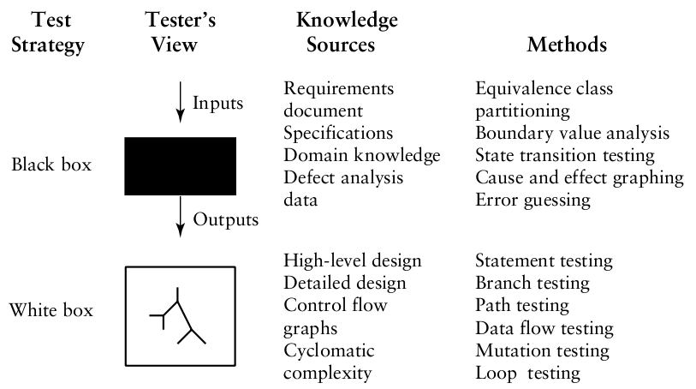
Test case design strategies
Software Testing - SE-UIT

Slide 7
Black-box test strategy
Tester considers the software-under-test
  To be an opaque box
  No knowledge of its inner structure (i.e., how it works)
  Has knowledge of what it does.
The size of the software-under-test
  A simple module
  Member function
  Object cluster to a subsystem
  A complete software system
Software Testing - SE-UIT
Notes:
Using the black box approach, a tester considers the software-under-
test to be an opaque box. There is no knowledge of its inner structure
(i.e., how it works). The tester only has knowledge of what it does. The
size of the software-under-test using this approach can vary from a simple
module, member function, or object cluster to a subsystem or a complete
software system. The description of behavior or functionality for the
software-under-test may come from a formal specification, an Input/Pro-
cess/Output Diagram (IPO), or a well-defined set of pre and post condi-
tions. Another source for information is a requirements specification doc-
ument that usually describes the functionality of the software-under-test
and its inputs and expected outputs. The tester provides the specified
inputs to the software-under-test, runs the test and then determines if the
outputs produced are equivalent to those in the specification. Because the
black box approach only considers software behavior and functionality,
it is often called functional, or specification-based testing. This approach
is especially useful for revealing requirements and specification defects.

Slide 8
Black-box test strategy
Consider only inputs and outputs as a basis for designing test cases
How do we choose a suitable set of inputs from the set of all possible valid and invalid inputs?
  Infinite time and resources are not available
  Example: Test a single procedure that calculates the square root of a number
Software Testing - SE-UIT
Notes:
Given the black box test strategy where we are considering only inputs
and outputs as a basis for designing test cases, how do we choose a suit-
able set of inputs from the set of all possible valid and invalid inputs?
Keep in mind that infinite time and resources are not available to ex-
haustively test all possible inputs. This is prohibitively expensive even if
the target software is a simple software unit. As a example, suppose you
tried to test a single procedure that calculates the square root of a number.
If you were to exhaustively test it you would have to try all positive input
values. This is daunting enough! But, what about all negative numbers,
fractions? These are also possible inputs. The number of test cases would
rise rapidly to the point of infeasibilty.

Slide 9
Black-box test strategy
The description of behavior or functionality for the software-under-test may come from
  A formal specification
  An Input/Process/Output Diagram (IPO)
  A well-defined set of pre and post conditions
  A requirements specification document
    usually describes the functionality of the software-under-test
    its inputs and expected outputs
Software Testing - SE-UIT
Notes:
Using the black box approach, a tester considers the software-under-
test to be an opaque box. There is no knowledge of its inner structure
(i.e., how it works). The tester only has knowledge of what it does. The
size of the software-under-test using this approach can vary from a simple
module, member function, or object cluster to a subsystem or a complete
software system. The description of behavior or functionality for the
software-under-test may come from a formal specification, an Input/Pro-
cess/Output Diagram (IPO), or a well-defined set of pre and post condi-
tions. Another source for information is a requirements specification doc-
ument that usually describes the functionality of the software-under-test
and its inputs and expected outputs. The tester provides the specified
inputs to the software-under-test, runs the test and then determines if the
outputs produced are equivalent to those in the specification. Because the
black box approach only considers software behavior and functionality,
it is often called functional, or specification-based testing. This approach
is especially useful for revealing requirements and specification defects.

Slide 10
Black-box test strategy
The tester
  provides the specified inputs to the software-under-test
  runs the test
  and then determines if the outputs produced are equivalent to those in the specification
Especially useful for revealing
  Requirements defects
  Specification defects
Software Testing - SE-UIT

Slide 11
White-box test strategy
Focuses on the inner structure of the software to be tested
  A tester must have a knowledge of that structure
  The code, or a suitable pseudo codelike representation must be available
The tester
  selects test cases to exercise specific internal structural elements to determine if they are working properly
Software Testing - SE-UIT
Notes:
The white box approach focuses on the inner structure of the software
to be tested. To design test cases using this strategy the tester must have
a knowledge of that structure. The code, or a suitable pseudo codelike
representation must be available. The tester selects test cases to exercise
specific internal structural elements to determine if they are working prop-
erly. For example, test cases are often designed to exercise all statements
or true/false branches that occur in a module or member function. Since
designing, executing, and analyzing the results of white box testing is very
time consuming, this strategy is usually applied to smaller-sized pieces of
software such as a module or member function. The reasons for the size
restriction will become more apparent in Chapter 5 where the white box
strategy is described in more detail. White box testing methods are es-
pecially useful for revealing design and code-based control, logic and se-
quence defects, initialization defects, and data flow defects.

Slide 12
White-box test strategy
Usually applied to smaller-sized pieces of software
  A module
  A member function
Especially useful for revealing
  Design and code-based control defects
  Logic and sequence defects
  Initialization defects
  Data flow defects
Software Testing - SE-UIT

Slide 13
Black-box vs. White-box test strategy
Each may be useful for revealing certain types of defects
With a suite of test cases designed using both strategies the tester increases the chances of revealing the many different type of defects in the software-under-test
Software Testing - SE-UIT
Notes:
The smart tester knows that to achieve the goal of providing users
with low-defect, high-quality software, both of these strategies should be
used to design test cases. Both support the tester with the task of selecting
the finite number of test cases that will be applied during test. Neither
approach by itself is guaranteed to reveal all defects types we have studied
in Chapter 3. The approaches complement each other; each may be useful
for revealing certain types of defects. With a suite of test cases designed
using both strategies the tester increases the chances of revealing the many
different type of defects in the software-under-test. The tester will also
have an effective set of reusable test cases for regression testing (re-test
after changes), and for testing new releases of the software.

Slide 14
Black-box test strategy
Software Testing - SE-UIT

Slide 15
How?
Random Testing
Equivalence Class Partitioning
Boundary Value Analysis
Cause-and-Effect Graphing
State Transition Testing
Error Guessing
Software Testing - SE-UIT

Slide 16
Random testing
Software Testing - SE-UIT

Slide 17
Random testing
Each software module or system has an input domain
That a tester randomly selects inputs from the domain
Example
  The valid input domain for a module is [1, 100] (integer)
  The tester randomly select values from the domain
    40, 78, 28
Software Testing - SE-UIT
Notes:
Each software module or system has an input domain from which test
input data is selected. If a tester randomly selects inputs from the domain,
this is called random testing

Slide 18
Some of the issues
Are the three values adequate to show that the module meets its specification when the tests are run? Should additional or fewer values be used to make the most effective use of resources?
Are there any input values, other than those selected, more likely to reveal defects?
  For example, should positive integers at the beginning or end of the domain be specifically selected as inputs?
Should any values outside the valid domain be used as test inputs?
  For example, should test data include floating point values, negative values, or integer values greater than 100?
Software Testing - SE-UIT

Slide 19
Advantage and disadvantage
Advantage
  Save some of the time and effort
Disadvantage
  Has very little chance of producing an effective set of test data
Software Testing - SE-UIT

Slide 20
Equivalence Class Partitioning
Software Testing - SE-UIT

Slide 21
Equivalence Class Partitioning
Partitioning of the input domain of the software-under-test
The technique can also be used to partition the output domain
  is not a common usage
Allow the tester to select a given member of an equivalence class as a representative of that class
Assumed
  that all members of an equivalence class are processed in an equivalent way by the target software
Software Testing - SE-UIT
Notes:
If a tester is viewing the software-under-test as a black box with well-
defined inputs and outputs, a good approach to selecting test inputs is to
use a method called equivalence class partitioning. Equivalence class par-
titioning results in a partitioning of the input domain of the software-
under-test. The technique can also be used to partition the output domain,
but this is not a common usage. The finite number of partitions or equiv-
alence classes that result allow the tester to select a given member of an
equivalence class as a representative of that class. It is assumed that all
members of an equivalence class are processed in an equivalent way by
the target software.

Slide 22
Equivalence Class Partitioning
Using equivalence class partitioning a test value in a particular class
  is equivalent to a test value of any other member of that class
If one test case in a particular equivalence class reveals a defect
  all the other test cases based on that class would be expected to reveal the same defect
Software Testing - SE-UIT
Notes:
Using equivalence class partitioning a test value in a particular class
is equivalent to a test value of any other member of that class. Therefore,
if one test case in a particular equivalence class reveals a defect, all the
other test cases based on that class would be expected to reveal the same
defect. We can also say that if a test case in a given equivalence class did
not detect a particular type of defect, then no other test case based on
that class would detect the defect (unless a subset of the equivalence class
falls into another equivalence class, since classes may overlap in some
cases).

Slide 23
Advantages
Eliminates the need for exhaustive testing, which is not feasible
Guides a tester in selecting a subset of test inputs with a high probability of detecting a defect
Allows a tester to cover a larger domain of inputs/outputs with a smaller subset selected from an equivalence class
Software Testing - SE-UIT

Slide 24
How does the tester identify equivalence classes?
“Interesting” input conditions (Glen Myers)
The input conditions usually come from
  a description in the specification of the software
The tester uses the conditions
  to partition the input domain into equivalence classes
  develops a set of test cases to cover (include) all the classes
Software Testing - SE-UIT

Slide 25
When does the tester begin develop black-box tests?
Early in the software life cycle in parallel with analysis activities
  Only the information in an input/output specification is needed
The tester and the analyst interact during the analysis phase to develop
  a set of testable requirements
  a correct and complete input/output specification
Software Testing - SE-UIT

Slide 26
When does the tester begin develop black-box tests?
From these the tester develops
  a high-level test plan
  a preliminary set of black box test cases for the system
Both the plan and the test cases undergo further development in subsequent life cycle phases
  V-Model
Software Testing - SE-UIT

Slide 27
Important points
The tester must consider both valid and invalid equivalence classes
  Invalid classes represent erroneous or unexpected inputs
Equivalence classes may also be selected for output conditions
The derivation of input or outputs equivalence classes is a heuristic process
  The conditions that are described in the following paragraphs only give the tester guidelines for identifying the partitions
  There are no hard and fast rules
  Given the same set of conditions, individual testers may make different choices of equivalence classes
Software Testing - SE-UIT

Slide 28
Important points
In some cases it is difficult for the tester to identify equivalence classes
  The conditions/boundaries that help to define classes may be
    Absent
    Obscure
    There may seem to be a very large or very small number of equivalence classes for the problem domain
  These difficulties may arise from an ambiguous, contradictory, incorrect, or incomplete specification and/or requirements description.
  Contact with analysts and user/client group may be required.
Software Testing - SE-UIT

Slide 29
List of conditions (1)
Suggestion by Myers
If an input condition is a range of values, select
  One valid equivalence class that covers the allowed range
  Two invalid equivalence classes, one outside each end of the range
Example: Input has range 1–499
  First equivalent class is [1, 499]
  Second equivalent class is (-∞, 1)
  Thirst equivalent class is (499, +∞)
Software Testing - SE-UIT

Slide 30
List of conditions (2)
If an input condition is a number of values, select
  One valid equivalence class that includes the allowed number of values
  Two invalid equivalence classes that are outside each end of the allowed number
Example: The specification for a real estate-related module say that a house can have one to four owners, we select
  One valid equivalence class that includes all the valid number of owners
  Two invalid equivalence classes for less than one owner and more than four owners
Software Testing - SE-UIT

Slide 31
List of conditions (3)
If an input condition is a set of valid input values, select
  One valid equivalence class that contains all the members of the set
  One invalid equivalence class for any value outside the set
Example: if the specification for a paint module states that the colors RED, BLUE, GREEN and YELLOW are allowed as inputs, select
  One valid equivalence class that includes the set RED, BLUE, GREEN and YELLOW
  One invalid equivalence class for all other inputs
Software Testing - SE-UIT

Slide 32
List of conditions (4)
If an input condition is a “must be” condition, select
  One valid equivalence class to represent the “must be” condition
  One invalid class that does not include the “must be” condition
Example: if the specification for a module states that the first character of a part identifier must be a letter, select
  One valid equivalence class where the first character is a letter
  One invalid class where the first character is not a letter
Software Testing - SE-UIT

Slide 33
List of conditions (5)
If the input specification or any other information leads to the belief that an element in an equivalence class is not handled in an identical way by the software-under-test, then the class should be further partitioned into smaller equivalence classes
Software Testing - SE-UIT

Slide 34
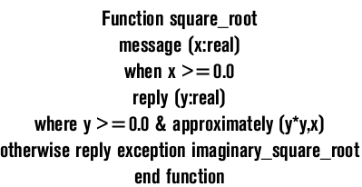
Example
A module that calculates a square root
Conditions relevant to the input/output variables x and y
Variable x must be
  A real number
  Equal to or greater than 0.0
Output variable y must be
  A real number
  Equal to or greater than 0.0
  Whose square is approximately equal to x
If x is not equal to or greater than 0.0, then an exception is raised
Software Testing - SE-UIT

Slide 35
Example
A module that calculates a square root
Input equivalence classes
  The input variable x is real, valid
  The input variable x is not real, invalid
  The value of x is greater than 0.0, valid
  The value of x is less than 0.0, invalid
Software Testing - SE-UIT

Slide 36
Development of the actual test cases
Each equivalence class should be assigned a unique identifier. A simple integer is sufficient
Develop test cases for all valid equivalence classes until all have been covered by (included in) a test case. A given test case may cover more than one equivalence class
Develop test cases for all invalid equivalence classes until all have been covered individually. This is to insure that one invalid case does not mask the effect of another or prevent the execution of another
Software Testing - SE-UIT

Slide 37
Boundary value analysis
Software Testing - SE-UIT

Slide 38
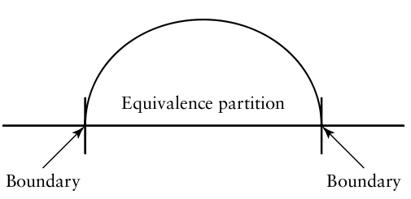
Boundary value analysis
Increase equivalence class partitioning strength
Experience,many defects occur directly on, and above and below, the edges of equivalence classes
Requires that the tester select elements close to the edges, so that both the upper and lower edges of an equivalence class are covered by test cases
Software Testing - SE-UIT

Slide 39
Rules (1)
If an input condition is a range of values, develop
  valid test cases for the ends of the range
  invalid test cases for possibilities just above and below the ends of the range
Example: Input has range [-1.0, +1.0]
  Valid test cases: -1.0, +1.0
  Invalid test cases: -1.1, 1.1
  This would result in input values of -1.0, -1.1, and 1.0, 1.1
Software Testing - SE-UIT

Slide 40
Rules (2)
If an input condition is a number of values, develop
  Valid test cases for the minimum and maximum numbers
  Invalid test cases that include one lesser and one greater than the maximum and minimum
Example: for the real-estate module mentioned previously that specified a house can have one to four owners, tests that include 0,1 owners and 4,5 owners would be developed
Software Testing - SE-UIT

Slide 41
Rules (3)
If the input or output is an ordered set, such as a table or a linear list, develop tests that focus on the first and last elements of the set
Software Testing - SE-UIT

Slide 42
Important
Conditions are not combined for equivalence class partitioning or boundary value analysis.
  Each condition is considered separately, and test cases are developed to insure coverage of all the individual conditions
Software Testing - SE-UIT

Slide 43
An example of the Application of Equivalence Class Partitioning and Boundary Value Analysis
Software Testing - SE-UIT

Slide 44
Description
Suppose we are testing a module that allows a user to enter new widget identifiers into a widget data base
The input specification for the module states that a widget identifier should consist of
  3–15 alphanumeric characters of which the first two must be letters
Software Testing - SE-UIT

Slide 45
Separate input conditions
It must consist of alphanumeric characters
The range for the total number of characters is between 3 and 15
The first two characters must be letters
Software Testing - SE-UIT

Slide 46
Designing the test cases
First we will
  identify input equivalence classes
  Give them each an identifier
Second we will augment these with the results from boundary value analysis
Software Testing - SE-UIT

Slide 47
Step 1 – Condition 1
The requirement for alphanumeric characters.
This is a “must be” condition
2 equivalence classes
  EC1. Part name is alphanumeric, valid
  EC2. Part name is not alphanumeric, invalid
Software Testing - SE-UIT

Slide 48
Step 1 – Condition 2
The range of allowed characters 3–15
This is a “range of values” condition
3 equivalence classes
  EC3. The widget identifier has between 3 and 15 characters, valid
  EC4. The widget identifier has less than 3 characters, invalid
  EC5. The widget identifier has greater than 15 characters, invalid
Software Testing - SE-UIT

Slide 49
Step 1 – Condition 3
The first two characters
This is a “must-be” condition
2 equivalence classes
  EC6. The first 2 characters are letters, valid
  EC7. The first 2 characters are not letters, invalid
Software Testing - SE-UIT

Slide 50
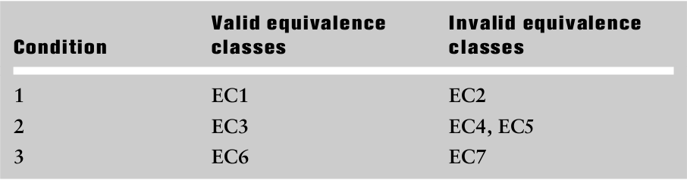
Step 1 - Table
Software Testing - SE-UIT

Slide 51
Step 2
A simple set of abbreviations represents the bounds groups
  BLB—a value just below the lower bound
  LB—the value on the lower boundary
  ALB—a value just above the lower boundary
  BUB—a value just below the upper bound
  UB—the value on the upper bound
  AUB—a value just above the upper bound
Software Testing - SE-UIT

Slide 52
Step 2
We have 6 values
  BLB—2
  BUB—14
  LB—3
  UB—15
  ALB—4
  AUB—16
Software Testing - SE-UIT

Slide 53
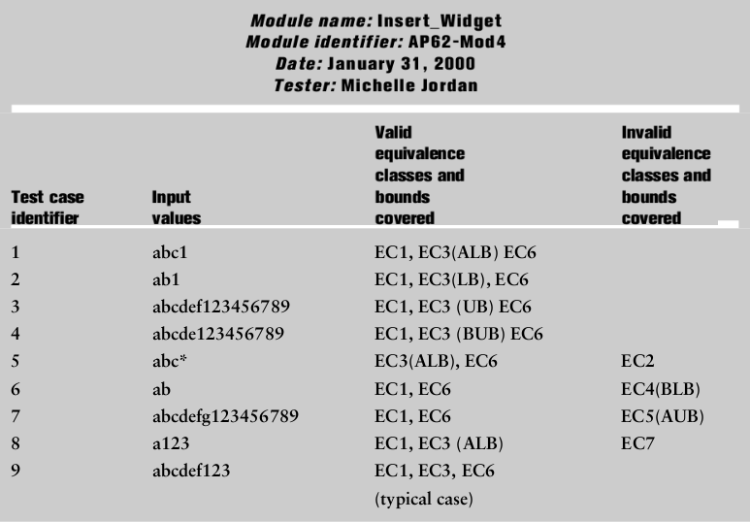
Summary
Software Testing - SE-UIT

Slide 54
Note
When selecting inputs based on equivalence classes
  A representative value at the midpoint of the bounds of each relevant class should be included as a typical case
Software Testing - SE-UIT

